Slide 1
Operating Systems
Chapter 5a
Process Scheduling
Hammad Afzal
hammad.afzal@mcs.edu.pk
Department of Computer Software Engineering
National University of Sciences and Technology

Slide 2
Chapter 5: CPU Scheduling
Chapter’s Roadmap
Basic Concepts
Scheduling Criteria
Scheduling Algorithms
Thread Scheduling
Multiple-Processor Scheduling
Operating Systems Examples
Algorithm Evaluation

Slide 3
Objectives
To introduce CPU scheduling, which is the basis for multi-programmed operating systems
To describe various CPU-scheduling algorithms
To discuss evaluation criteria for selecting a CPU-scheduling algorithm for a particular system

Slide 4
Basic Concepts
Maximum CPU utilization obtained with multiprogramming
Main Idea behind Scheduling is: Keep more than one process in memory, and when one process is waiting, bring other processes to CPU.
Scheduling is a fundamental operating system function.
All computer resources are scheduled before use.
CPU is one of primary computer resources.

Slide 5
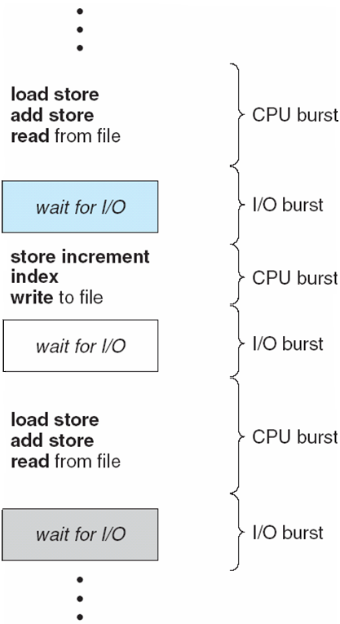
Basic Concepts
Observed property of processes:
CPU–I/O Burst Cycle – Typical Process execution consists of a cycle of CPU execution and I/O wait
Process alternate between these two states.

Slide 6
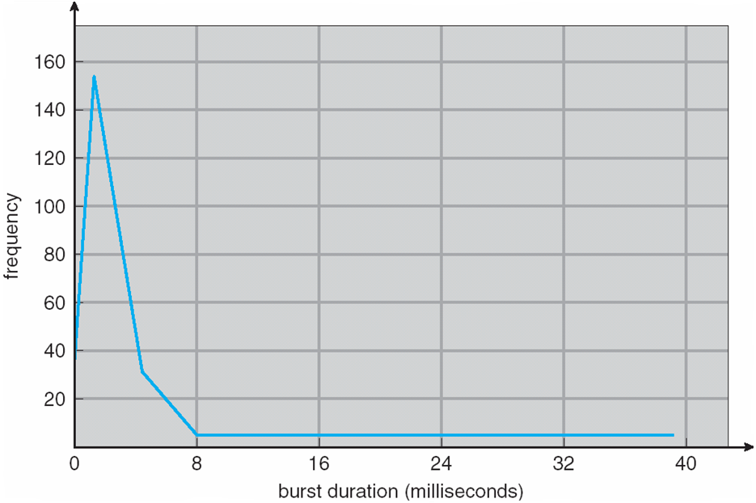
Histogram of CPU-burst Times
An observed pattern of CPU bursts.
This distribution can be important in selection of an appropriate CPU scheduling algorithm.

Slide 7
CPU Scheduler
Selects from among the processes in ready queue, and allocates the CPU to one of them
Done by short-term scheduler.
Queue may be ordered in various ways (not necessarily FIFO)
Queue can be a FIFO, a priority queue, a tree or simply an unordered linked list.
However, conceptually all processes are waiting in ready queue to get chance for execution.
Records in queue are generally PCBs of the processes.

Slide 8
CPU Scheduler
CPU scheduling decisions may take place when a process:
1. Switches from running to waiting state (for I/O request or invocation of wait for termination of any child process)
2. Switches from running to ready state (e.g. interrupt occurs).
3. Switches from waiting to ready (e.g. completion of I/O).
Terminates
Scheduling under 1 and 4 is non-preemptive or cooperative.
Used in Windows 3.x
It does not require any special hardware platform (e.g. timer)

Slide 9
CPU Scheduler
All other scheduling is preemptive,
However it has a cost
Consider access to shared data
Two processes accessing a shared data.
Solution: Chapter 6.
Consider preemption while in kernel mode.
Kernel doing system call on behalf of a process. E.g. changing some I/O queues.
If process is preempted in mid of changes, and kernel needs to read or modify the queues, Chaos ensues.
Some OSs do not allow the preemption while doing system call.

Slide 10
CPU Scheduler
All other scheduling is preemptive,
However it has a cost
Consider interrupts occurring during crucial OS activities.
Interrupts must be handled and cannot be ignored always by kernel.
Section of code affected by interrupts must be guarded from simultaneous use.
In order to make sure that some sections of code are not accessed concurrently by several processes, they disable interrupts at entry and re-enable interrupts at exit.

Slide 11
Dispatcher
Dispatcher module gives control of the CPU to the process selected by the short-term scheduler; this involves:
Switching context
Switching to user mode
Jumping to the proper location in the user program to restart that program
Dispatch latency – time it takes for the dispatcher to stop one process and start another running
Should be very fast.

Slide 12
Scheduling Criteria
Different scheduling algorithms have different properties.
Choice of algo may favour one class of processes over other.
CPU utilization – keep the CPU as busy as possible
Typically 40 to 90 percent
Throughput – # of processes that complete their execution per time unit.
May differ for long and short processes (can be 1 process per hour to 10 processes per second).
Turnaround time – (from a process view point) amount of time to execute a particular process
Interval between time of submission of process to time of completion.

Slide 13
Scheduling Criteria
Waiting time – amount of time a process has been waiting in the ready queue.
Scheduling algorithm does not affect the time of execution or does I/O.
Response time
amount of time it takes from when a request was submitted until the first response is produced, not output (for time-sharing environment).

Slide 14
Scheduling Criteria
Scheduling Algorithm Optimization Criteria
Maximize CPU utilization and throughout and to minimize turnaround time, waiting time and response time.
In most cases, we optimize average measures, however in some cases it is desirable to optimize minimum or maximum values.
For example, in interactive systems, what should be the aim about dealing with response time ?

